Slide 1

GL trial balance check
<xbrli:xbrl>
<gl-cor:accountingEntries>
<gl-cor:entryHeader>
<gl-cor:qualifierEntry …>balance-brought-forward</ …>
<gl-cor:entryDetail>
<gl-cor:amount …>242678.26</ …>
<gl-cor:debitCreditCode …">D</ …>
</gl-cor:entryDetail>
…
</ gl-cor:entryHeader>
<gl-cor:entryHeader>
<gl-cor:qualifierEntry …>standard</ …>
<gl-cor:entryDetail>
<gl-cor:amount …>242678.26</ …>
<gl-cor:debitCreditCode …">D</ …>
</gl-cor:entryDetail>
…
</ gl-cor:entryHeader>
</ gl-cor:accountingEntries>
</ xbrli:xbrl>
account
balances
D – debit
C - credit
period’s
changes
Check if sections are in balance:
sum(amts with ‘D’ siblings) =
sum(amts with ‘C’ siblings)

Slide 2
General filter
Just an XPath 2 expression
  Need to test if sibling of amount is credit code
<gl-cor:entryDetail>
<gl-cor:amount …>242678.26</ …>
<gl-cor:debitCreditCode …">D</ …>
</gl-cor:entryDetail>
  test=“../gl-cor:debitCreditCode eq ‘D’”

Slide 3
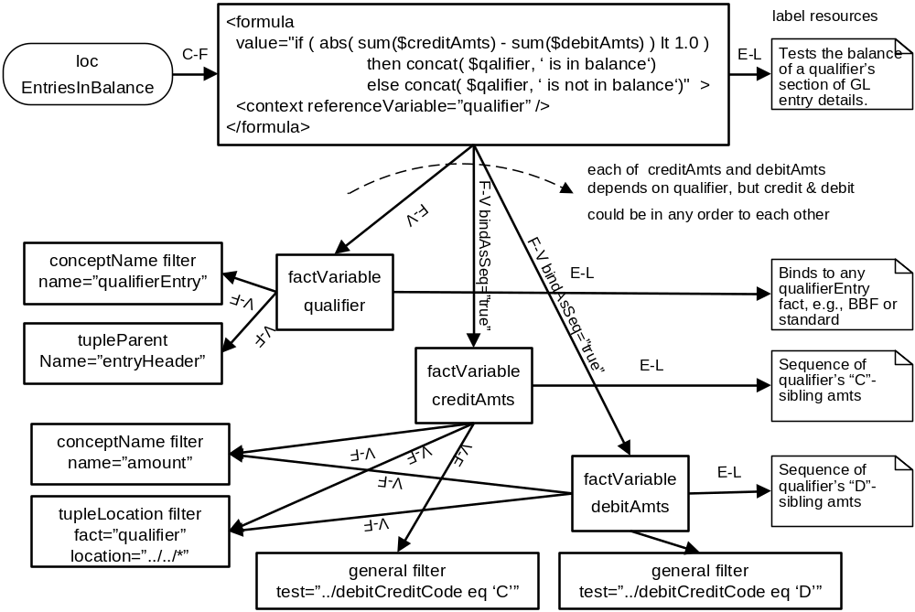
Trial balance checks

Slide 4
Value filter
Value matches an XPath 2 expression
Not Nil test
Nil test
Precision expression

Slide 5
GL ending balance computation
<xbrli:xbrl>
<gl-cor:accountingEntries>
<gl-cor:entryHeader>
<gl-cor:qualifierEntry …>balance-brought-forward</ …>
<gl-cor:entryDetail>
<gl-cor:account>
<gl-cor:accountMainID …>5100</ …>
<gl-cor:accountMainDescription …>Supplies</ …>
<gl-cor:accountType …>account</ …>
</gl-cor:account>
<gl-cor:amount …>242678.26</ …>
<gl-cor:debitCreditCode …">D</ …>
<gl-cor:xbrlInfo>
<gl-cor:xbrlInclude …>beginning_balance</…>
</gl-cor:xbrlInfo>
</gl-cor:entryDetail>
…
</ gl-cor:entryHeader>
<gl-cor:entryHeader>
<gl-cor:qualifierEntry …>standard</ …>
<gl-cor:entryDetail>
…
</gl-cor:entryDetail>
…
</ gl-cor:entryHeader>
</ gl-cor:accountingEntries>
</ xbrli:xbrl>
aggregate by
account
skip ending_balances

Slide 6
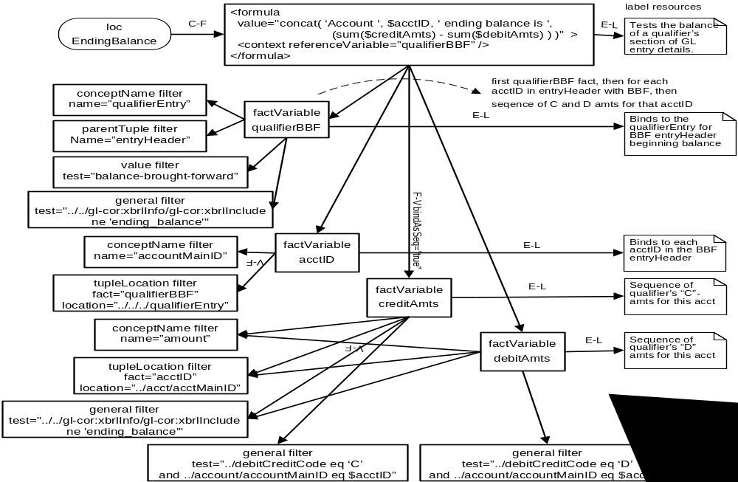
GL ending balance computation

Slide 7
GL ending balance test
Added 2 more variables
  For each account
    Get amount for ending-balance entry with ‘C’ (credit) code
    Get amount for ending-balance entry with ‘D’ (debit) code
  Change equation to test
    Sum (credits which are not ending-balance -
    debits which are not ending-balance +
    credit which is ending-balance –
    debit which is not ending-balance) < 1.00

